Slide 1
Does the Weather in Atlanta make us Crazy in Traffic!?
Amber Pizzo
Alex Caughman
John Shows
Steven White

Slide 2
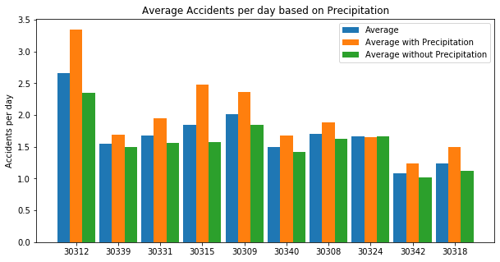
Does weather cause more traffic accidents?
Using data analyzed in Jupyter Notebook; we found that during the two year period (2018-2019) the 10 zip codes in Atlanta with the highest accident counts experience more accidents on average when it rains.
Let’s examine further and determine the confidence we have of this finding and explore other weather conditions that may have similar effects during the same two year period.
Notes:
Motivation & Summary Slide * Define the core message or hypothesis of your project. * Describe the questions you asked, and _why_ you asked them * Describe whether you were able to answer these questions to your satisfaction, and briefly summarize your findings.

Slide 3

Data Sources
Traffic Data: Kaggle - US Accidents (3.5 million records) A Countrywide Traffic Accident Dataset (2016 - 2020)
Acknowledgements
Moosavi, Sobhan, Mohammad Hossein Samavatian, Srinivasan Parthasarathy, and Rajiv Ramnath. “A Countrywide Traffic Accident Dataset.”, 2019.
Moosavi, Sobhan, Mohammad Hossein Samavatian, Srinivasan Parthasarathy, Radu Teodorescu, and Rajiv Ramnath. "Accident Risk Prediction based on Heterogeneous Sparse Data: New Dataset and Insights." In proceedings of the 27th ACM SIGSPATIAL International Conference on Advances in Geographic Information Systems, ACM, 2019.
Accident records include accident severity, start time, end time, latitude and longitude of accident, city, state, zip code, description of accident, length of road extant affected by accident, street address.
Weather Data: Visual Crossing Weather API (Worldwide weather history reports & global 15-day weather forecasts via CSV download, API, & Excel)
In order to evaluate our questions about Atlanta Traffic and weather we were able to merge our Traffic data with our Weather data on date and then filter to get weather in Atlanta. From there we filtered the data on zip code to do the bulk of our analysis.
Notes:
* Questions & Data * Elaborate on the questions you asked, describing what kinds of data you needed to answer them, and where you found it

Slide 4
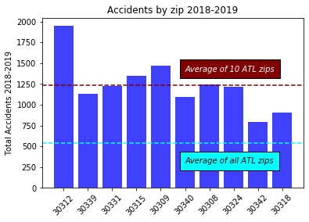
Atlanta Traffic
Add Amber’s Heatmap here too
Notes:
Traffic Data – Discuss the way the traffic was cleaned up and applied…..talk about how we determined the 10 zips we included in our analysis…..
Data Cleanup & Exploration * Describe the exploration and cleanup process * Discuss insights you had while exploring the data that you didn't anticipate * Discuss any problems that arose after exploring the data, and how you resolved them * Present and discuss interesting figures developed during exploration, ideally with the help of Jupyter Notebook

Slide 5
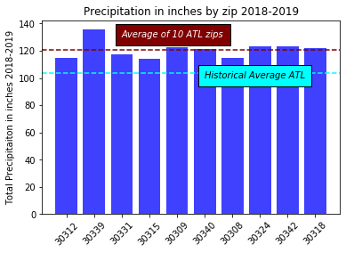
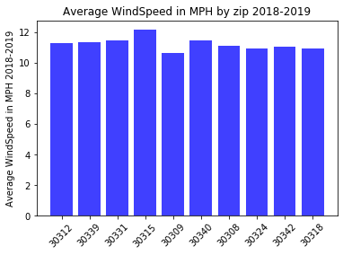
Atlanta Weather
Notes:
Weather Data – Discuss the way the weather was cleaned up and applied…..

Slide 6
Atlanta Traffic and Weather
Data Analysis * Discuss the steps you took to analyze the data and answer each question you asked in your proposal * Present and discuss interesting figures developed during analysis, ideally with the help of Jupyter Notebook

Slide 7
Atlanta Traffic and Weather
Discussion * Discuss your findings. Did you find what you expected to find? If not, why not? What inferences or general conclusions can you draw from your analysis?

Slide 8
Atlanta Traffic and Weather
Discussion * Discuss your findings. Did you find what you expected to find? If not, why not? What inferences or general conclusions can you draw from your analysis?

Slide 9
Atlanta Traffic and Weather
Post Mortem * Discuss any difficulties that arose, and how you dealt with them * Discuss any additional questions that came up, but which you didn't have time to answer: What would you research next, if you had two more weeks?

Slide 10
QUESTIONS?
Amber Pizzo
Alex Caughman
John Shows
Steven White

